Slide 1


Adventure Without Limits

Slide 2
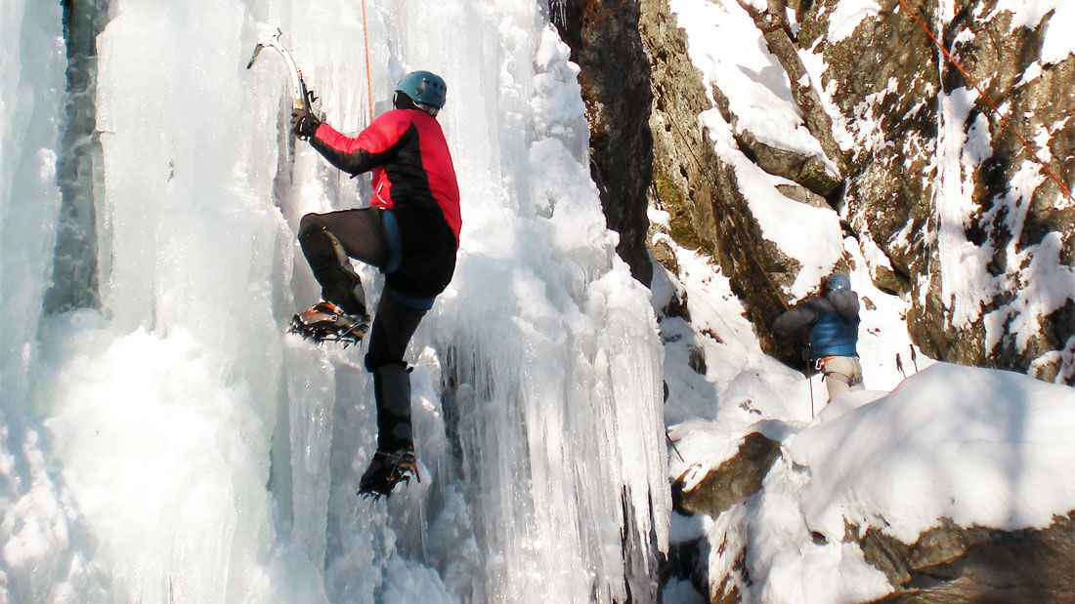


Slide 3
“Adventure Without Limits”
Notes:
We are Falcn, and we are solving Kendra’s problem. At Falcn, You focus on the adventure, and we’ll take care of everything else.
-Motivated team, across the country

Slide 4
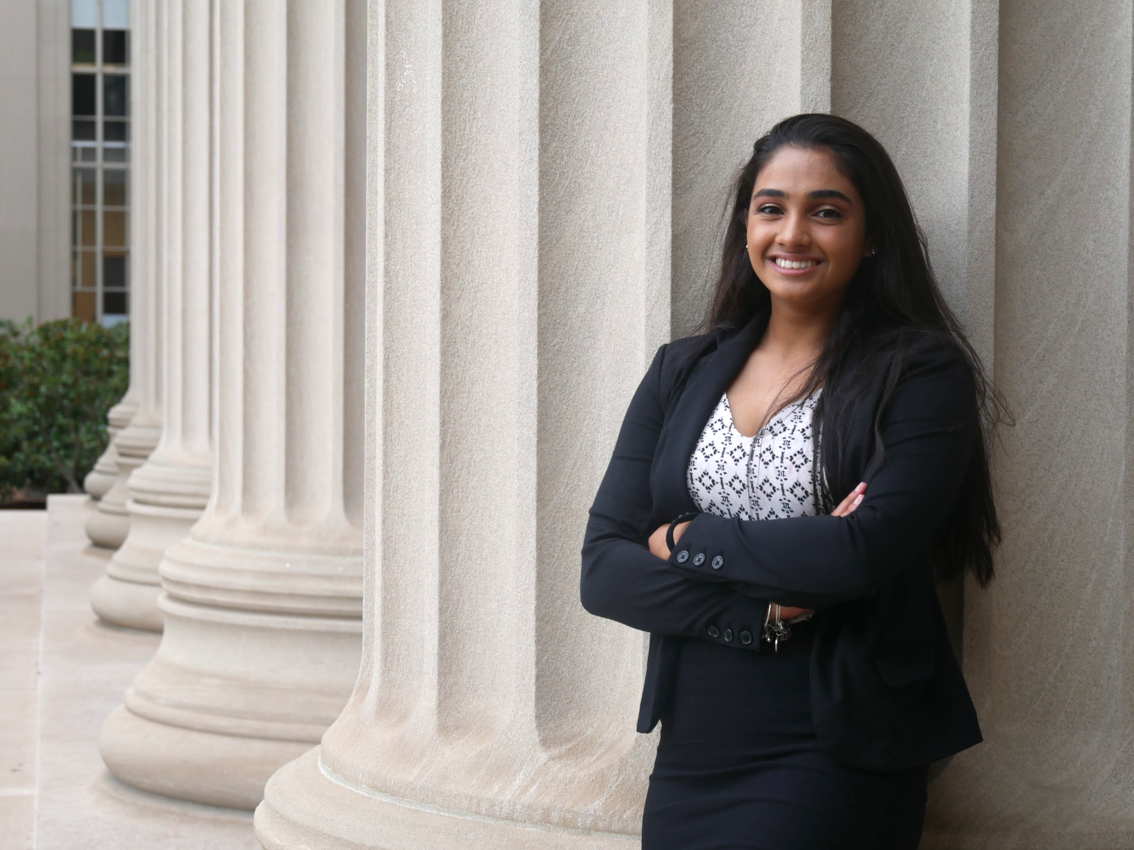
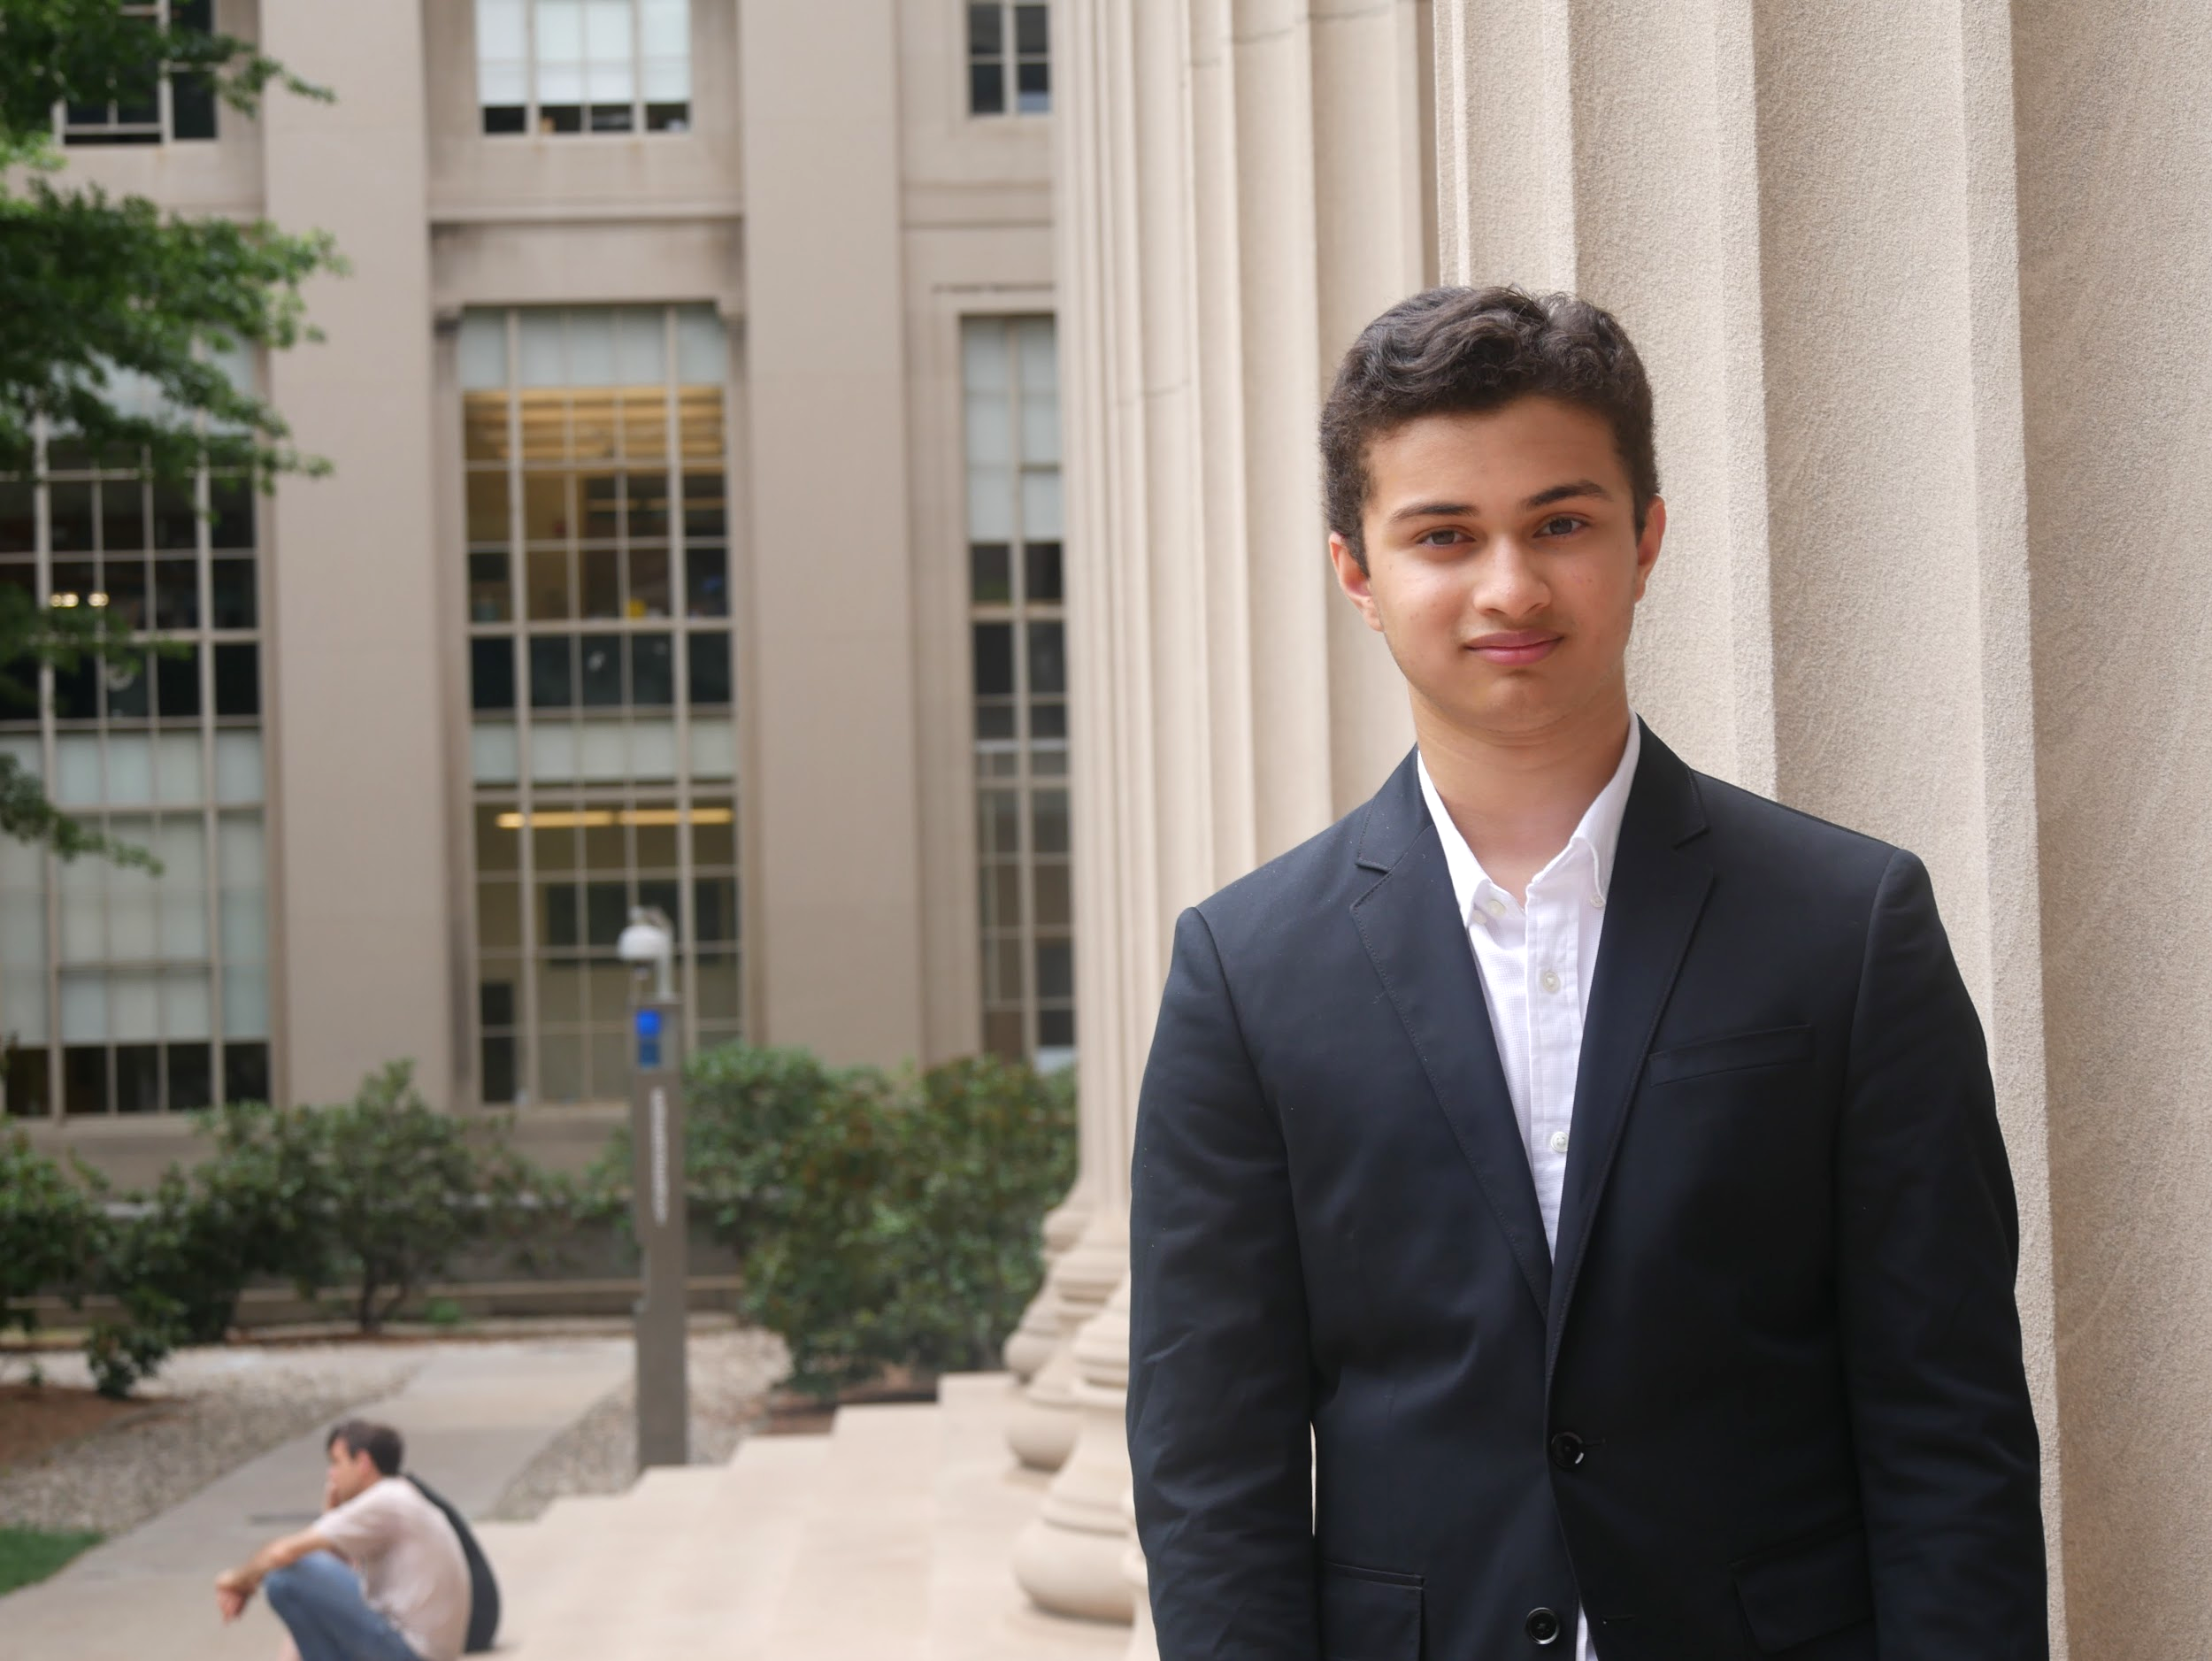
We Can Turn this Dream into a Reality!
Neha Subrahmanyam
Om Deshmukh
Notes:
Say our names

Slide 5
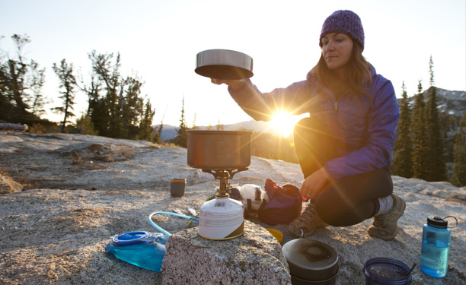
Meeting
Market Needs
Notes:
After talking to over 50 high adventure climbers able to find burning need
They always looking to cut down on space, and weight and competition was clumsy and unreliable
- choose ™ as 30-50 high adv campers that travel in groups for more than 4 days at a time
Person saying make a collapsible and durable pot quote
Know camping is competitive market so...

Slide 6
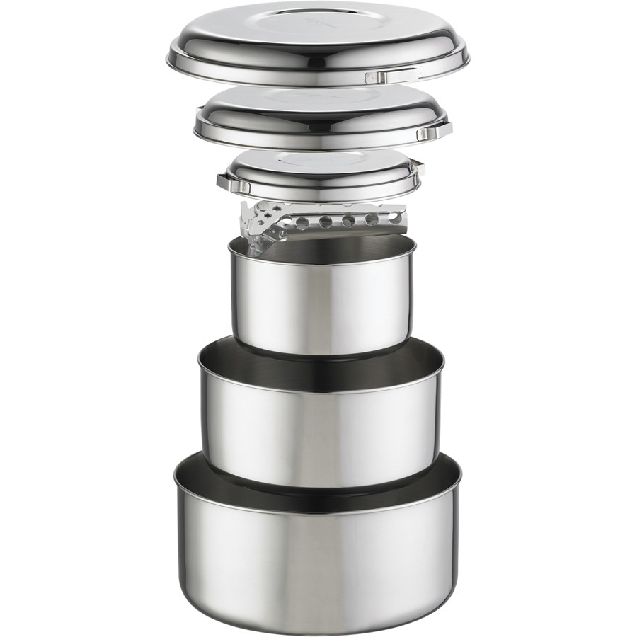
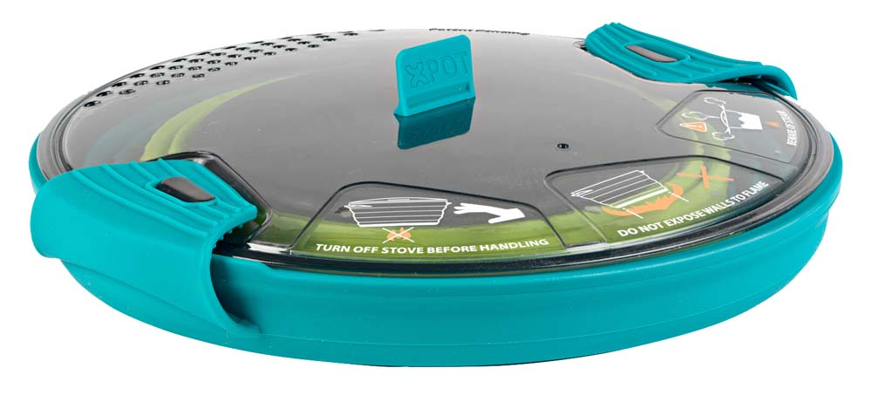
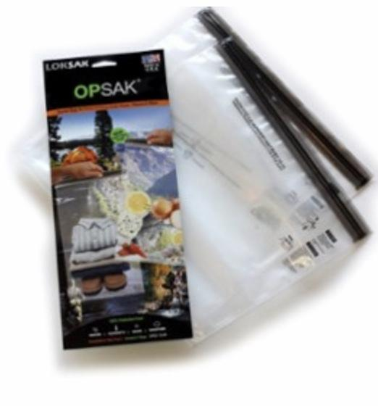
Durability
Portability
Notes:
2 types
1) -explain how it works
- durable but lots of space
Hard in groups
2) - easy space, weight,
Cooking w plastic is bad, not durable, only make H20
our solution is both durable and collapsible “best of both world”

Slide 7
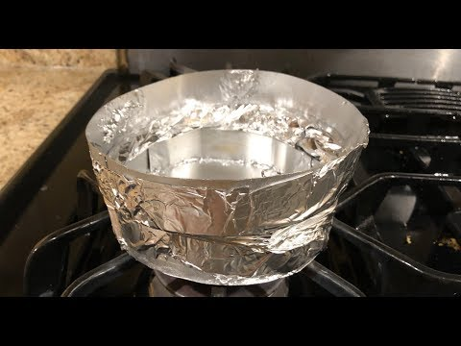
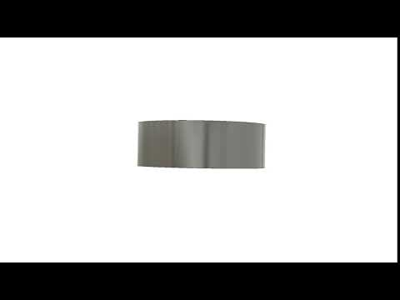
Durable, Portable, and Efficient!

Slide 8
Costs
Revenue
$38
$85
$47
55%
Cost of Goods Sold
Price
Profit
Gross Margin
Notes:
We will be pricing this pot as a high end product on the market in order to target the high adventure campers discussed in the previous slide.
Pricing at 150 with a 70 profit and 47% gross margins which is about the industry average gross margins at 50
Comparable 1L pots are:
$88.99 (Vargo BOT)
$57.88 (700 mL Evernew Titanium Pot)
$59.95 (850 mL MSR Titan Pot)
$44.95 (1.4 L Sea to Summit X-Pot)

Slide 9
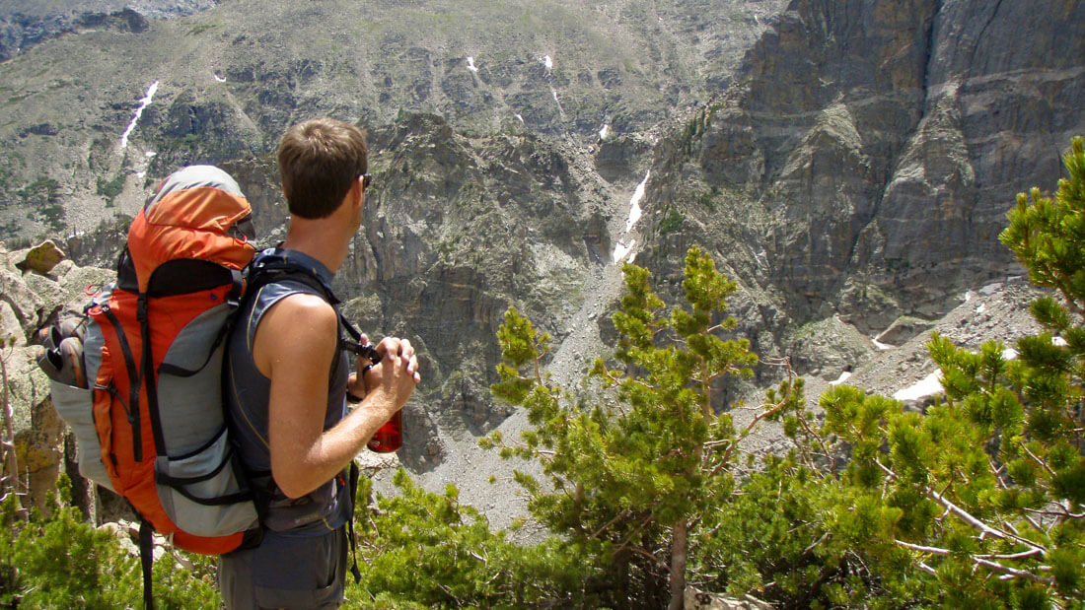
Possible: 9.1 million
Initial: 700,000
Notes:
-Target market size - amount of money high adventure campers (camp more than 10 times annually) spend on camping cookware
25% of all campers
11% new england
$546 spent per camper
30% spent on cookware

Slide 10






Go-To-Market
2018-19
2020
2020
2019
2019
Q4
Q2
Q3
Q1
Q3
Research and
Development
Kickstarter
Crowdfunding
Manufacturing
Launch:
Professionals and Mountain Guides
Expansion: Outdoors Groups
Consumer Testing and Iteration

Slide 11






Implementation Strategy
Phase 1 - Professional Climbers
Phase 2 - Outing Clubs
Hierarchical Diffusion
Notes:
Implementation split into 2 stages
1: Professionals - easy to find contact info, cold calling and marketing, low cost but time intensive, hierarchical diffusion, burning need
2: Outing Clubs - higher end clubs, contact rosters, diffuse cost

Slide 12
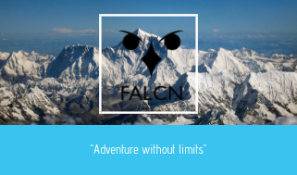

Adventure Without Limits

